Slide 1
Love in Learning

Slide 2
Once there was a girl who thought she was no good at anything

Slide 3
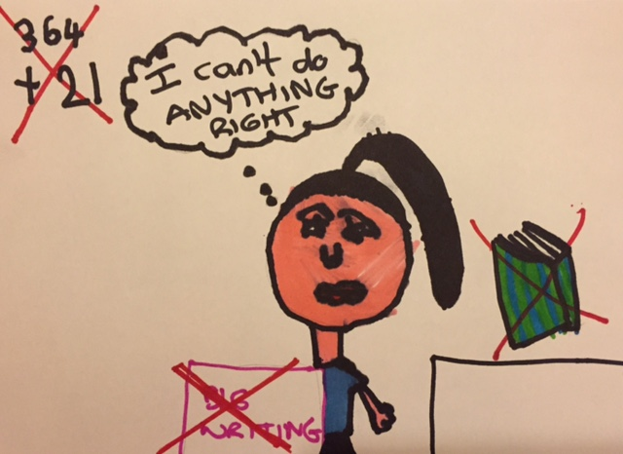
She found maths really hard, spelling really hard and writing even harder…. She thought she was stupid

Slide 4
She was ALWAYS getting into trouble, for talking, not listening, yelling, shouting and hitting people!

Slide 5
One day she met a lady who had a room full of toys and they played together and talked. The lady noticed that the girl thought she was no good at anything and had given up on herself and learning….

Slide 6
The lady drew a circle and said “school can sometimes feel like maths, literacy and reading are the MOST important things….”
reading
maths
Geography
Science
Art
literacy

Slide 7
“Maths, literacy and reading ARE important things to LEARN but the most important thing is that you are yourself...”

Slide 8
Then the lady asked the girl to do a pie chart of the things she liked to do and found easy to do
Art
Playing
Being with her family
Swimming
Riding her bike

Slide 9
The lady then drew a pie chart with a big YOU in the middle.
Literacy
Reading
“if you focus on being all of you, activities are just the things you DO, they are not what makes you who you ARE”
Playing
Art
YOU
Being with her family
Swimming
Riding her bike
Talking
Maths
Science

Slide 10
When you were born people would look at you and say:
Being YOU is easy… just breath, gently… like you did as a baby…
“What a beautiful baby! You are so amazing”

Slide 11
You can stay that amazing!

Slide 12
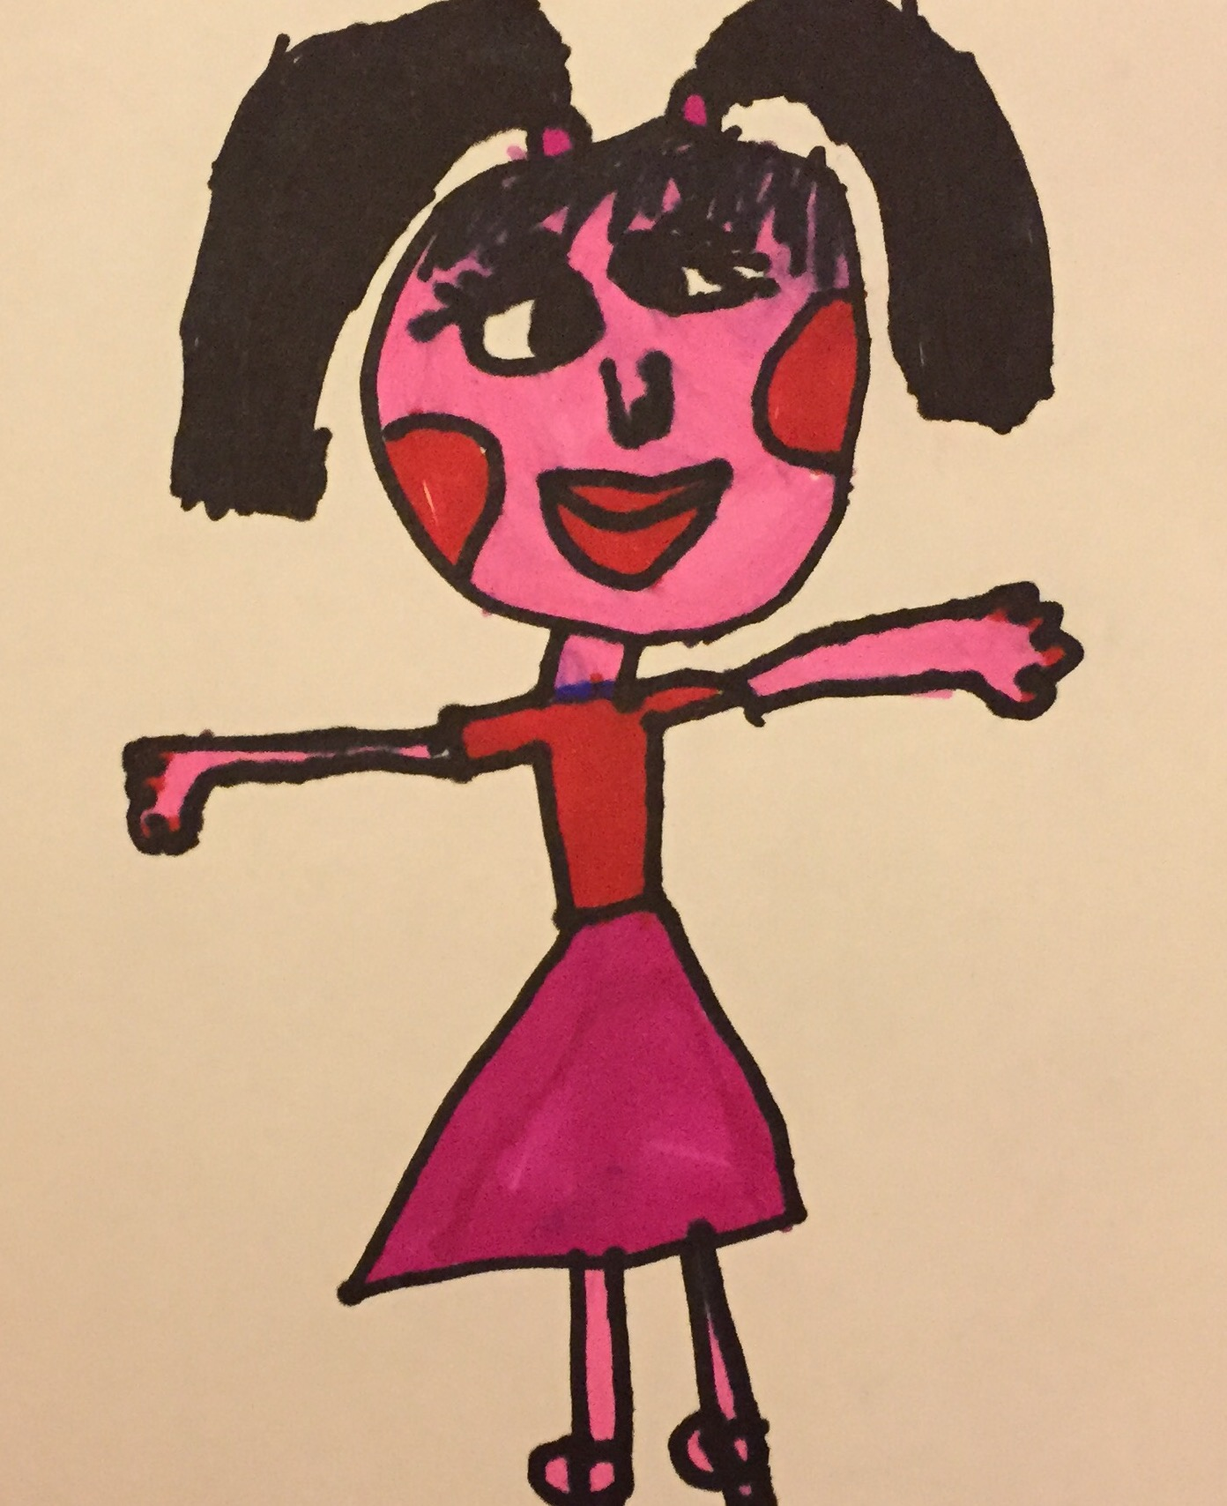
“I have noticed that when you come into the room you are able to make the dolls house beautiful and ordered within moments….”
The lady said to the girl “you have a talent” the girl looked wide eyed…

Slide 13
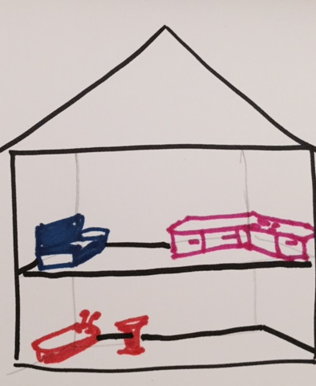
“there is a job called interior design and you would be very good at it, you help people design their homes, I have never seen a child create the space and beauty of the doll house like you do.”
The girl thought this was nothing and not a talent…..the lady said….

Slide 14
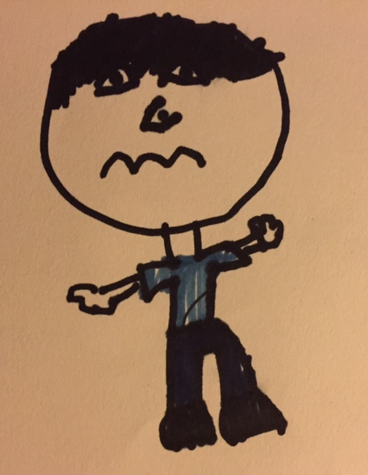
Once there was a boy who found school really easy, he found maths easy, literacy easy, reading easy

Slide 15
…. he was very scared to get anything wrong so he didn’t like to try new things, he would ONLY do the things he knew he was good at
The only problem was he thought that Maths, Reading, Literacy made him who he was!
reading
maths
literacy

Slide 16
He had thoughts like…. “I have to GET it” I can’t ask for help I will look like I don’t know and I am the smart one I am the clever one people will be disappointed if I get it wrong, I CAN’T MAKE A MISTAKE…

Slide 17
This time the lady helped him to relax and remember that he is more than what he does, it’s great that he finds things easy at school but he needed help to see it was normal and ok to not do everything well AND that he was loveable even if he got things wrong

Slide 18
Reading
Literacy
Art
Playing
YOU
Being with her family
Swimming
Riding her bike
Talking
Maths
Science

Slide 19
You are not better if you can do maths, literacy, reading easily and you are not less if you find them tricky you’re….. JUST LEARNING!
We are all born equal as babies.

